Slide 1
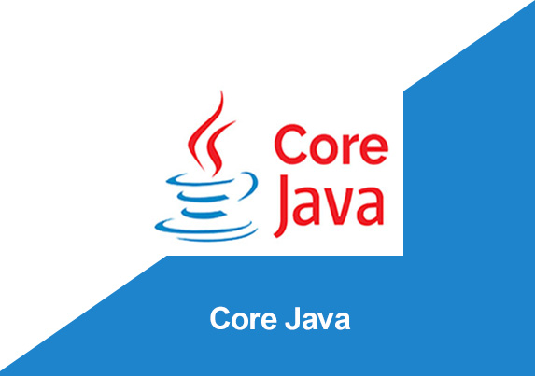
By: Manas Tuwani

Slide 2
STRUCTURE OF THE JAVA PROGRAM
package packagename;
import Statements (Optional);
public class ClassName {
public static void main(String[] args)
{
Statements;
Statements;
Statements;
}
}

Slide 3
Naming Conventions in Java
Java is pure case sensitive language and strictly following the below naming conventions.
Package: package name should always start with lower case.
And it should not contain any special characters and space
Example: package packone;
Package pack2 etc.
Class: Class name should start with upper case and first character of every word in a class name should be upper case. And it should not contain any special characters and space.
Example: class ClassOne
Class ClassOneTwo

Slide 4
Naming Conventions in Java
Method/Function: Method/Function should starts with lower case and first character of second word onwards should be upper case.
Example: methodOne(); methodOneTwo();
methodOneTwoThree();

Slide 5
Note:
Method name, package name, class name should not contain spaces, should start with alphabets and can contains numeric. If we are specifying the public class in java program, the file name should be same as class name.

Slide 6
OPERATORS IN JAVA
We are using operators to perform the operations in a java program. We are using 3 different types of operators in JAVA.
Note: Without using operators, we can’t write even single program in Java
1. Arithmetic Operators: We are using arithmetic operators to perform mathematical operations like addition, subtraction, multiplication etc.
Addition, String concatenation +
Subtraction, negation -
Multiplication *
Division /
Equal =
Reminder %
Increment ++
Decrement --

Slide 7
Java Arithmetic Operator Example
public class OperatorExample
{
public static void main(String args[]) {
int a=10;
int b=5;
System.out.println(a+b); //15
System.out.println(a-b); //5
System.out.println(a*b); //50
System.out.println(a/b); //2
System.out.println(a%b); //0
}
}

Slide 8
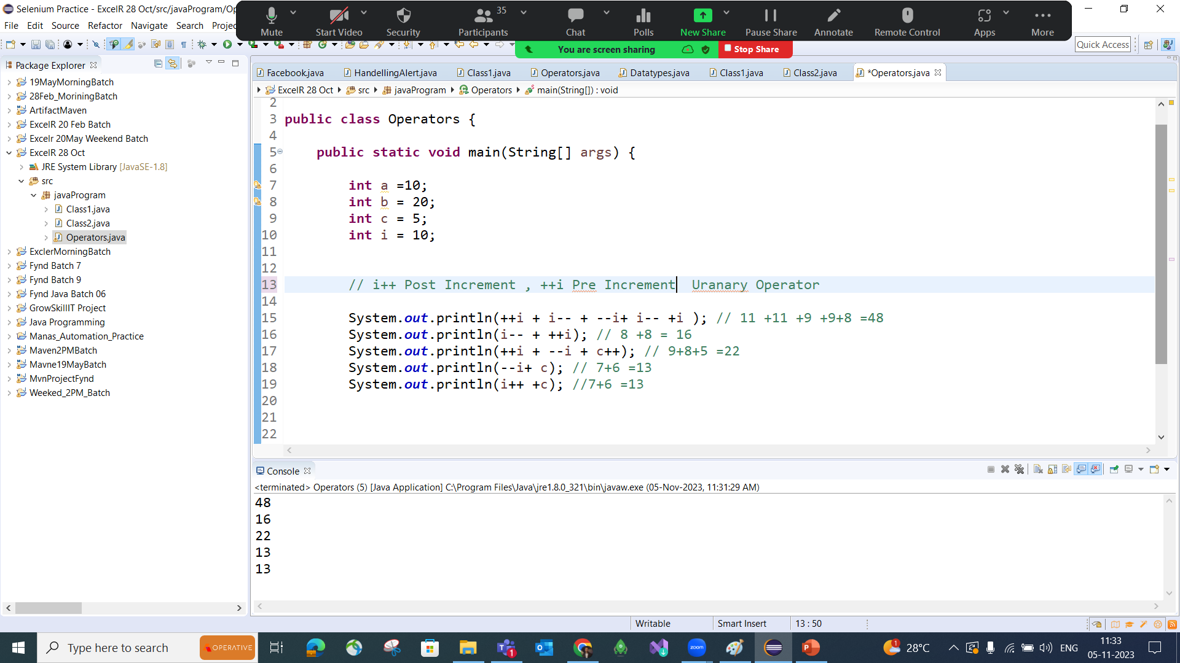
Unary Operator or Increment-Decrement Operator Program

Slide 9
OPERATORS IN JAVA
2. Conditional Operators: To check/verify the conditions in a java program. (Relational operators). These are giving Boolean results.
Less than <
Greater than >
Less than equal to <=
Greater equal >=
Double equal ==
Not equal !=

Slide 10
OPERATORS IN JAVA
3. Logical Operators: To perform the logical operations in a Java Program.
AND (Any 1 condition false result false) &&
OR (Any 1 condition true result true) ||
Note: Operators are mandatory in every language but the syntaxes might different from one language to another language

Slide 11
Logical Operator Example
public class OperatorExample
{
public static void main(String args[]){
int a=10;
int b=5;
int c=20;
System.out.println(a<b&&a<c); //false
}
}

Slide 12
Logical Operator Example
public class OperatorExample
{
public static void main(String args[]) {
int a=10;
int b=5;
int c=20;
System.out.println(a>b||a<c); //true
}
}

Slide 13
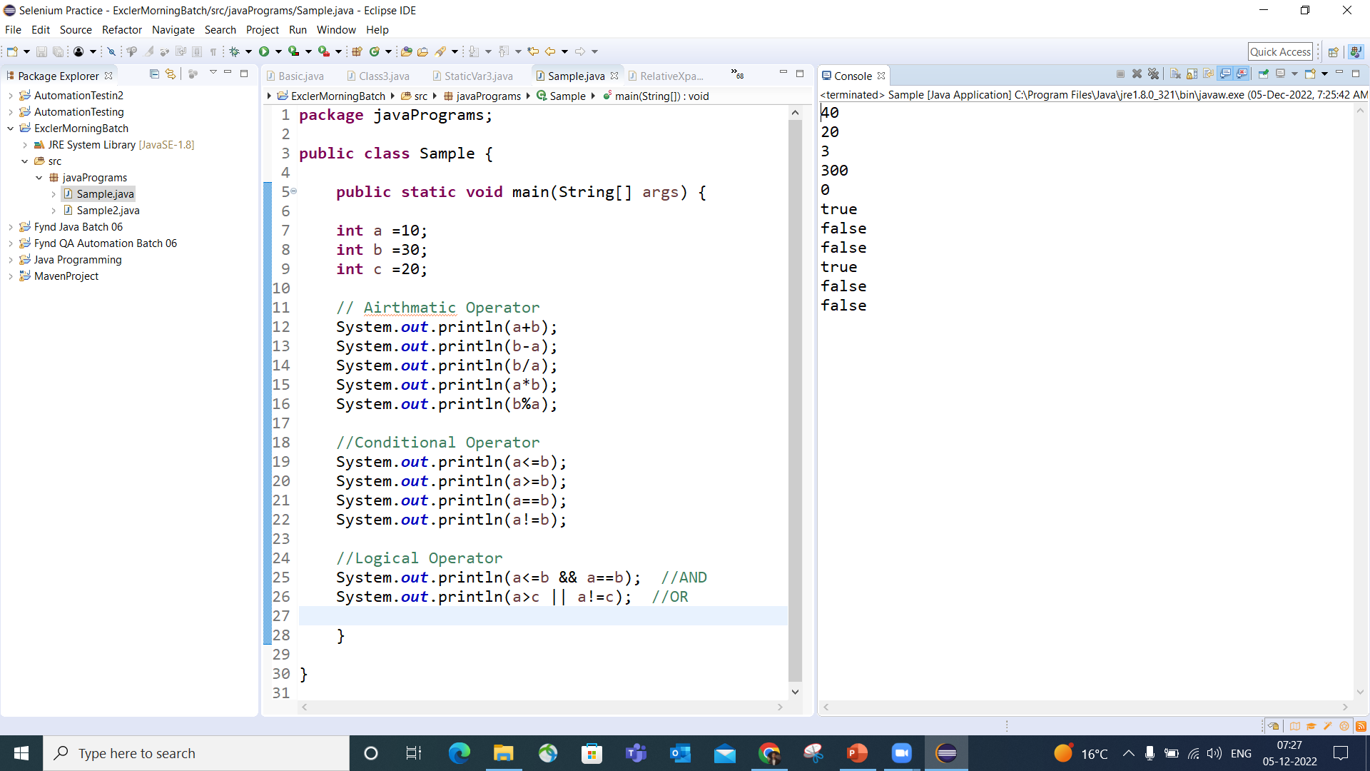

Slide 14
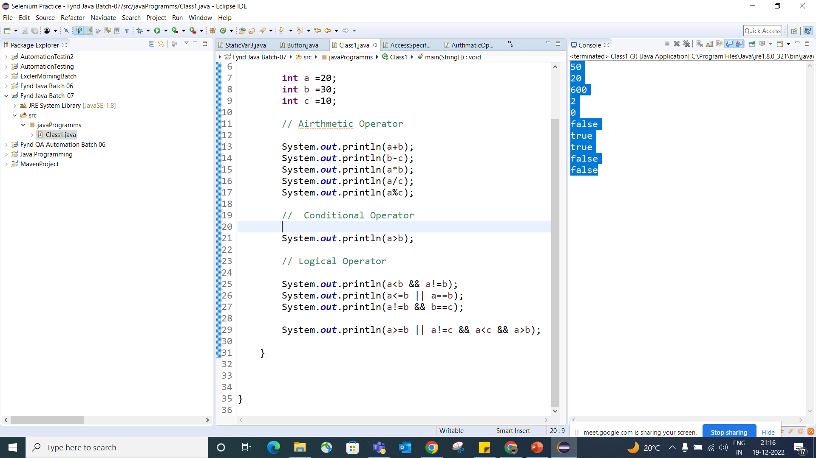

Slide 15
